Slide 1
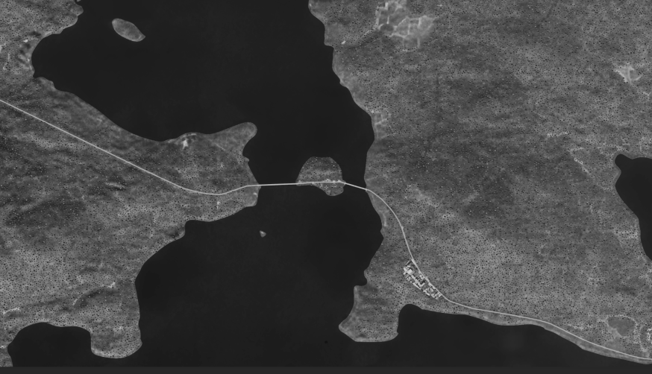
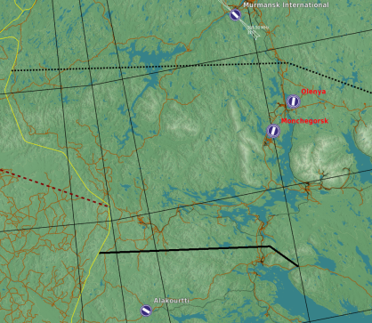


SRNTGT056 Oz Imandra Bridge E105
SRNTGT056
N
BE ADVISED! WATER TARGET – BUT NOT SEA LEVEL! – 449 FT
--- POWER LINE DIR. NORTH OF BRIDGE LINE ---
1
DESCRIPTION OF THE DESIRED POINTS OF IMPACT WITH WPN TYPE:
SRNTGT056A - PILLAR
DPI1 N 67°36.384’ E033°03.174’ / 449 ft / (500 Ibs bomb)

